Slide 1
Hackathon GenAI based Earning Calls Analyzer Fortune 500 Companies
Members Name:
Debasis Tiari
Varun, D Mohre
Damara Mohana Reddy, B
Padmini, Palli
Ashutosh Kumar
Team Number : 05

Slide 2
Agenda
Approach
Solution & Flow Design/Architecture Design
Conclusion
Challenges & Future Enhancements

Slide 3
Approach
Overview:
Automates extraction, processing, and analysis of financial data from PDFs.
Focuses on comparing CapEx values across companies/quarters.
Utilizes Azure services, AI models, and Python libraries.
Results are presented through a Streamlit web interface.
Core AI Engine:
Azure OpenAI Service: Extracts financial data using NLP, generating JSON outputs.
NLP Techniques: Ensures accurate data extraction and categorization.
Frameworks & Tools:
Azure Services:
Blob Storage: Stores and retrieves PDF files.
Azure OpenAI: Processes text and extracts financial metrics.
Python Libraries:
Streamlit: User interface.
PyPDF2: PDF text extraction.
Pandas & NumPy: Data analysis and manipulation.
io, os, json, concurrent.futures: Data handling and parallel processing.
Azure Integration:
Data Storage & Retrieval: PDFs stored in Azure Blob Storage.
AI-Powered Extraction: AI model extracts and organizes financial metrics.
Data Processing: Compares CapEx across quarters using Pandas.
Web Interface: Streamlit app for user interaction, viewing results, and downloading data.

Slide 4

Solution & Flow Design/Architecture Design
Datastores
Azure Blob Storage
(PDF Storage & Retrieval)
Retrieve PDFs from Blob Storage (earningcalltranscripts)
Download Options Users can download in CSV or view in the app
Services
Python Orchestration
Run Analysis
List & Fetch PDFs
AI-driven Text Processing
Multi-threaded PDF Processing (Parallel)
Environment Variables
(Secure Connection Strings,| API Keys using `python-dotenv)
Frontend
Extract text from PDF using PyPDF
Output saved in Cloud Bucket
Streamlit UI
Check token limit (truncate if necessary)
OpenAI API
Azure cloud
JSON with extracted data (CapEx, company info year, Quarter)
UI Output
End Users
CapEx in Tabular
format
Structured Financial Data
(JSON to DataFrame Conversion, Pivot Table Creation)
Financial Data Comparison & Validation
(CapEx across quarters)

Slide 5
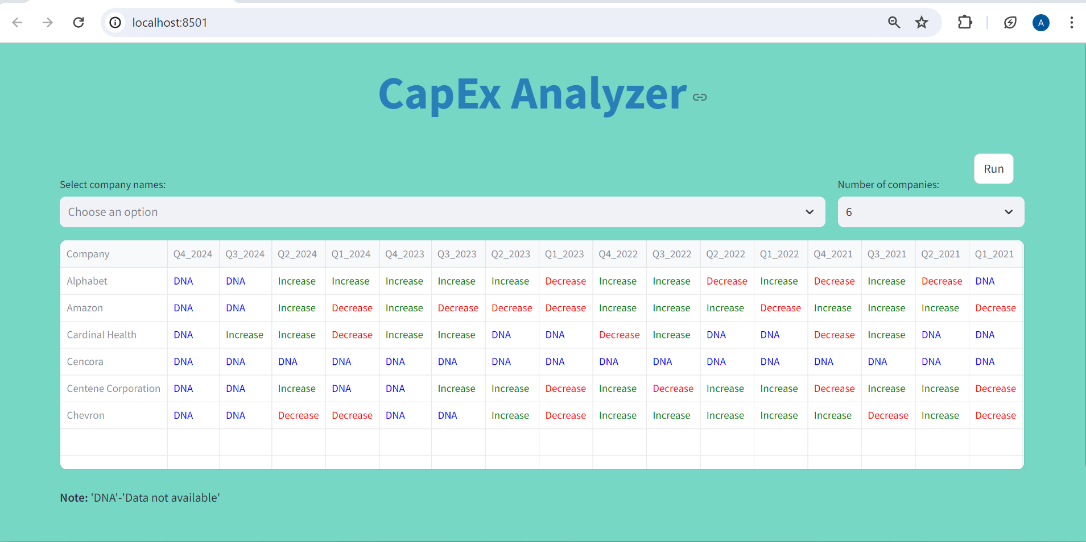
User Interface
Click here to experience UI
Capex_Analyzer_Code_Base

Slide 6
Conclusion
In our project, Leveraging ChatGPT 3.5 Turbo, Azure Storage, and PyPDF for text extraction enabled us to efficiently extract relevant parameters based on user prompts. We utilized parallel processing to effectively reduce execution time.
This Streamlit app efficiently processes financial data from PDFs stored in Azure Blob Storage by extracting, analyzing, and comparing CapEx metrics across companies and quarters, into a structured format, and provides downloadable results, for users.

Slide 7
Challenges & Future Enhancements
Challenges
Due to budget constraints, we were unable to explore or experiment with the latest models and prompt tuning techniques.
Additionally, use of the ChatGPT 3.5 Turbo model led to token limit issues, which hindered our ability to extract complete text from PDFs, occasionally resulting in incomplete transaction data.
Furthermore, some PDFs were in image or non-editable formats, which posed challenges for text extraction.
Future Enhancements​
To address these challenges and improve our approach, we propose the following future enhancements: ​
Exploration of Advanced Models: We plan to experiment with more advanced models, such as GPT-4, or advance models to leverage their improved capabilities and potentially overcome existing limitations.​
Improved Data Extraction Techniques: We aim to extract balance sheet tables separately to target the financial terminologies directly.​ We also aim to apply chunking and semantic search to improve the overall performance of the model. Splitting pages into smaller chunk will help to reduce the token outflow issue whereas semantic search help to target those pages where the exact matching present.​
By implementing these enhancements, we anticipate more robust and comprehensive solutions for data extraction and analysis in future iterations of our project.​

Slide 8
Thank you

